Slide 1
CPE 150: Introduction to Programming
Chapter 1: Introduction to Computers and C++ Programming
Copyright notice: 1- care has been taken to use only those web images deemed by the instructor to be in the public domain. If you see a copyrighted image on any slide and are the copyright owner, please contact the instructor. It will be removed.
2- These slides are inspired, based, and modified with permission from the authors of the C++ How to Program (4th Edition) textbook

Slide 2
Topics To Be Covered In Chapter 1
1.1 Introduction 1.2 What is a Computer? 1.6 Machine Languages, Assembly Languages, and High-Level Languages 1.14 Basics of a Typical C++ Environment 1.21 A Simple Program: Printing a Line of Text 1.22 Another Simple Program: Adding Two Integers 1.23 Memory Concepts 1.24 Arithmetic

Slide 3
1.1 Introduction
Software
Instructions to command computer to perform actions and make decisions
Hardware
Standardized version of C++
United States
American National Standards Institute (ANSI)
Worldwide
International Organization for Standardization (ISO)
Structured programming
Object-oriented programming

Slide 4
1.2 What is a Computer?
Computer
Device capable of performing computations and making logical decisions
Computer programs
Sets of instructions that control computer’s processing of data
Hardware
Various devices comprising computer
Keyboard, screen, mouse, disks, memory, CD-ROM, processing units, …
Software
Programs that run on computer

Slide 5
1.6 Machine Languages, Assembly Languages, and High-level Languages
Three types of computer languages
Machine language
Only language computer directly understands
“Natural language” of computer
Defined by hardware design
Machine-dependent
Generally consist of strings of numbers
Ultimately 0s and 1s
Instruct computers to perform elementary operations
One at a time
Cumbersome for humans
Example:
101001010101001 010100010000010 110010001001001

Slide 6
1.6 Machine Languages, Assembly Languages, and High-level Languages
Three types of computer languages
Assembly language
English-like abbreviations representing elementary computer operations
Clearer to humans
Incomprehensible to computers
Translator programs (assemblers)
Convert to machine language
Example:
LOAD BASEPAY ADD OVERPAY STORE GROSSPAY

Slide 7
1.6 Machine Languages, Assembly Languages, and High-level Languages
Three types of computer languages
High-level languages
Similar to everyday English, use common mathematical notations
Single statements accomplish substantial tasks
Assembly language requires many instructions to accomplish simple tasks
Translator programs (compilers)
Convert to machine language
Interpreter programs
Directly execute high-level language programs
Example:
grossPay = basePay + overTimePay

Slide 8
1.14 Basics of a Typical C++ Environment
Phases of C++ Programs:
Edit
Preprocess
Compile
Link
Load
Execute

Slide 9
1.21 A Simple Program: Printing a Line of Text
Comments
Document programs
Improve program readability
Ignored by compiler
Single-line comment
Begin with //
Preprocessor directives
Processed by preprocessor before compiling
Begin with #

Slide 10
1 // Fig. 1.2: fig01_02.cpp
2 // A first program in C++.
3 #include <iostream>
4
5 // function main begins program execution
6 int main()
7 {
8 std::cout << "Welcome to C++!\n";
9
10 return 0; // indicate that program ended successfully
11
12 } // end function main
Single-line comments.
Function main returns an integer value.
Left brace { begins function body.
Preprocessor directive to include input/output stream header file <iostream>.
Function main appears exactly once in every C++ program..
Statements end with a semicolon ;.
Corresponding right brace } ends function body.
Stream insertion operator.
Name cout belongs to namespace std.
Keyword return is one of several means to exit function; value 0 indicates program terminated successfully.
Welcome to C++!

Slide 11
1.21 A Simple Program: Printing a Line of Text
Standard output stream object
std::cout
“Connected” to screen
<<
Stream insertion operator
Value to right (right operand) inserted into output stream
Namespace
std:: specifies using name that belongs to “namespace” std
std:: removed through use of using statements
Escape characters
\
Indicates “special” character output

Slide 12
1.21 A Simple Program: Printing a Line of Text

Slide 13
1 // Fig. 1.4: fig01_04.cpp
2 // Printing a line with multiple statements.
3 #include <iostream>
4
5 // function main begins program execution
6 int main()
7 {
8 std::cout << "Welcome ";
9 std::cout << "to C++!\n";
10
11 return 0; // indicate that program ended successfully
12
13 } // end function main
Multiple stream insertion statements produce one line of output.
Welcome to C++!

Slide 14
1 // Fig. 1.5: fig01_05.cpp
2 // Printing multiple lines with a single statement
3 #include <iostream>
4
5 // function main begins program execution
6 int main()
7 {
8 std::cout << "Welcome\nto\n\nC++!\n";
9
10 return 0; // indicate that program ended successfully
11
12 } // end function main
Using newline characters to print on multiple lines.
Welcome
to
C++!

Slide 15
1.22 Another Simple Program: Adding Two Integers
Variables
Location in memory where value can be stored
Common data types
int - integer numbers
char - characters
double - floating point numbers
Declare variables with name and data type before use
int integer1;
int integer2;
int sum;
Can declare several variables of same type in one declaration
Comma-separated list
int integer1, integer2, sum;

Slide 16
1.22 Another Simple Program: Adding Two Integers
Variables
Variable names
Valid identifier
Series of characters (letters, digits, underscores)
Cannot begin with digit
Case sensitive
C++ keywords
Cannot be used as identifiers or variable names

Slide 18
1.22 Another Simple Program: Adding Two Integers
Input stream object
>> (stream extraction operator)
Used with std::cin
Waits for user to input value, then press Enter (Return) key
Stores value in variable to right of operator
Converts value to variable data type
= (assignment operator)
Assigns value to variable
Binary operator (two operands)
Example:
sum = variable1 + variable2;

Slide 19
1 // Fig. 1.6: fig01_06.cpp
2 // Addition program.
3 #include <iostream>
4
5 // function main begins program execution
6 int main()
7 {
8 int integer1; // first number to be input by user
9 int integer2; // second number to be input by user
10 int sum; // variable in which sum will be stored
11
12 std::cout << "Enter first integer\n"; // prompt
13 std::cin >> integer1; // read an integer
14
15 std::cout << "Enter second integer\n"; // prompt
16 std::cin >> integer2; // read an integer
17
18 sum = integer1 + integer2; // assign result to sum
19
20 std::cout << "Sum is " << sum << std::endl; // print sum
21
22 return 0; // indicate that program ended successfully
23
24 } // end function main
Declare integer variables.
Use stream extraction operator with standard input stream to obtain user input.
Calculations can be performed in output statements: alternative for lines 18 and 20:
std::cout << "Sum is " << integer1 + integer2 << std::endl;
Stream manipulator std::endl outputs a newline, then “flushes output buffer.”
Concatenating, chaining or cascading stream insertion operations.
Enter first integer
45
Enter second integer
72
Sum is 117

Slide 20
1.23 Memory Concepts
Variable names
Correspond to actual locations in computer's memory
Every variable has name, type, size and value
When new value placed into variable, overwrites previous value
Reading variables from memory nondestructive

Slide 21
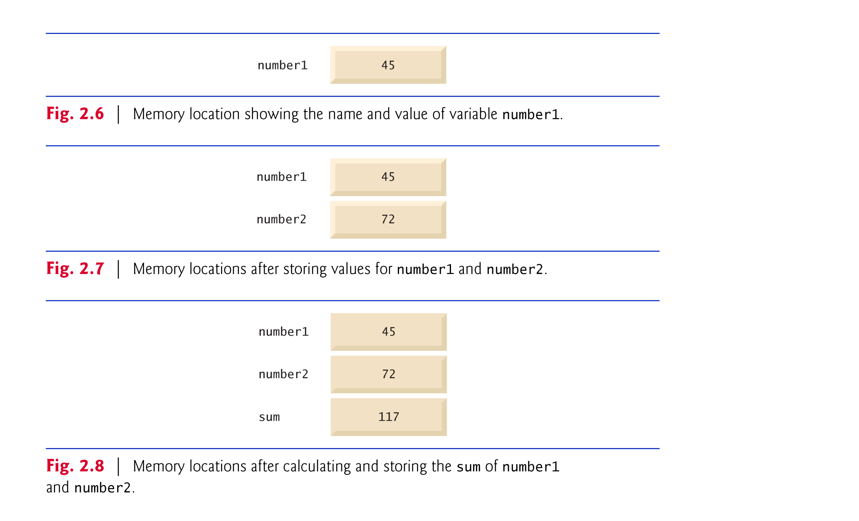
1.23 Memory Concepts
std::cin >> number1;
Assume user entered 45
std::cin >> number2;
Assume user entered 72
sum = number1 + number2;

Slide 22
1.24 Arithmetic
% Modulus operator returns remainder
7 % 5 evaluates to 2
Integer division truncates remainder
7 / 5 evaluates to 1

Slide 23
1.24 Arithmetic
Rules of operator precedence
Operators in parentheses evaluated first
Nested/embedded parentheses
Operators in innermost pair first
Multiplication, division, modulus applied next
Operators applied from left to right
Addition, subtraction applied last
Operators applied from left to right

Slide 24
1.24 Arithmetic

Slide 25
